Slide 1
The Parabolic Reflector Microphone
Cameron Pagan
Mount Saint Mary College
MTH 4040

Slide 2
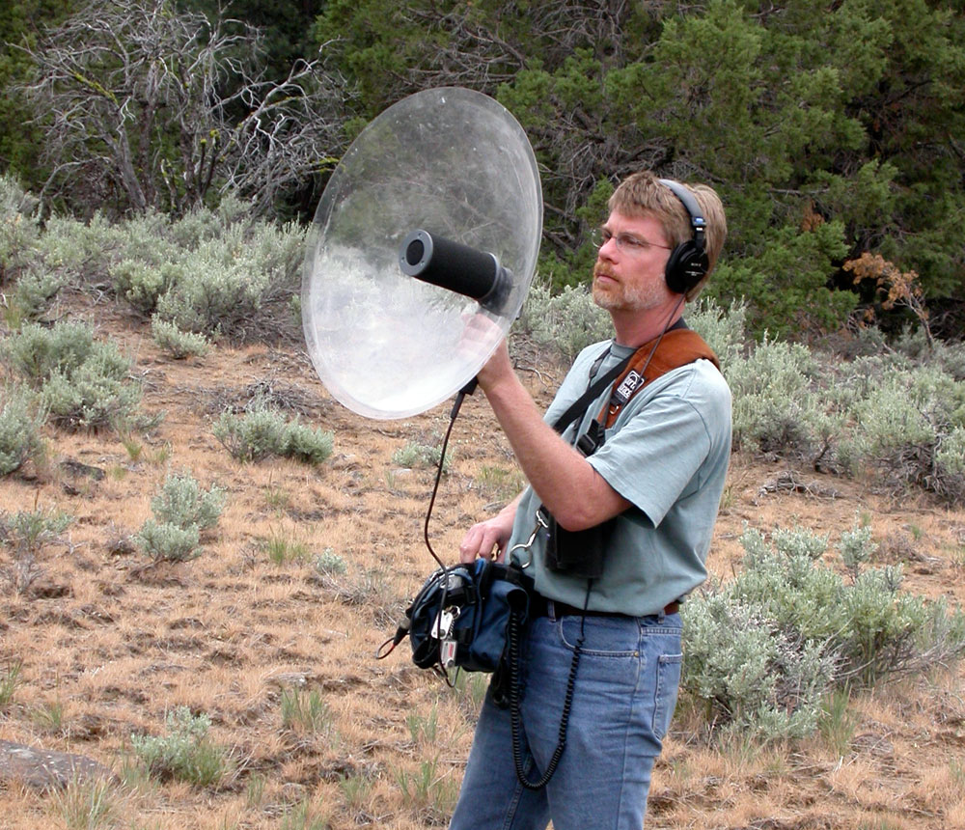
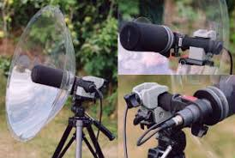
What is it?
A parabolic microphone is an instrument that uses a parabolic reflector to collect and focus sound waves on a transducer.
A transducer is a device that converts energy from one form to another. (In this case, it turns sound energy into electrical energy.)

Slide 3
What is it used for?
Sporting Events (Field Audio)
Bird Calls
Eavesdropping (Espionage and Law Enforcement)
Useful since it can pick up sounds from long distances

Slide 4
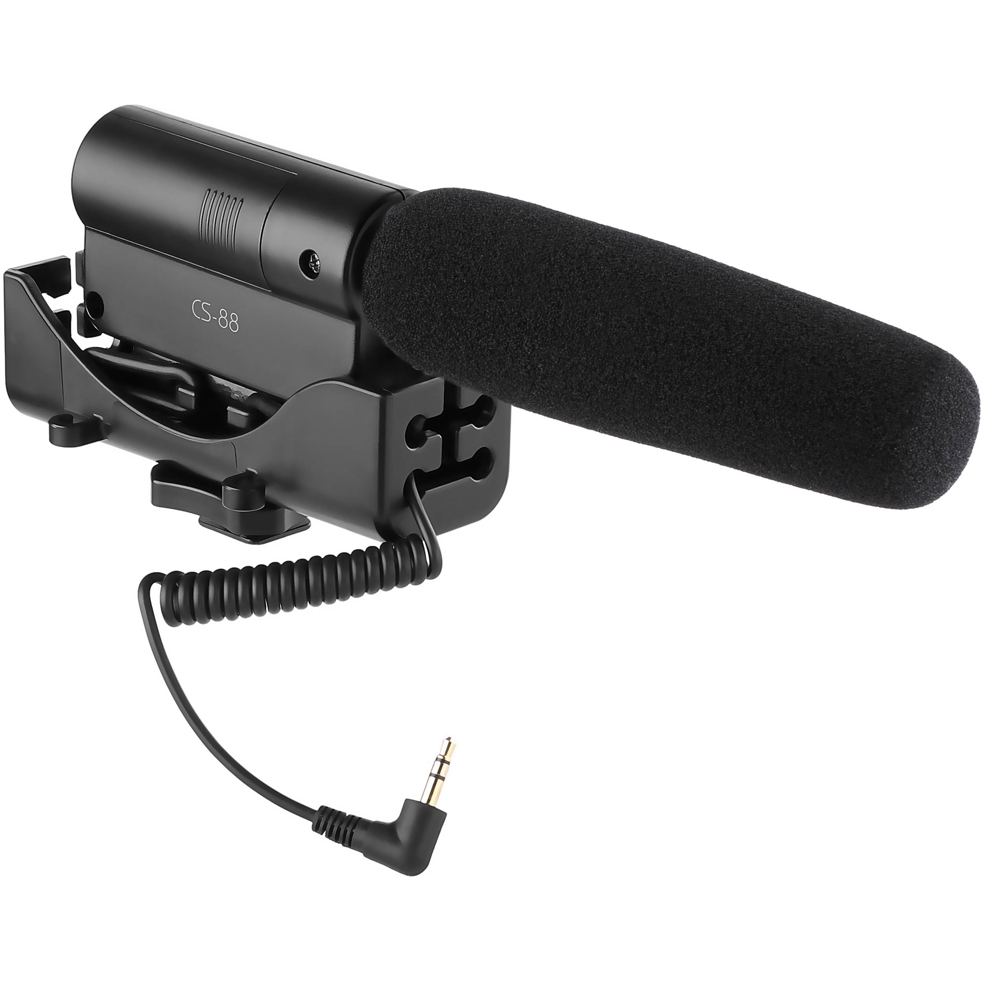
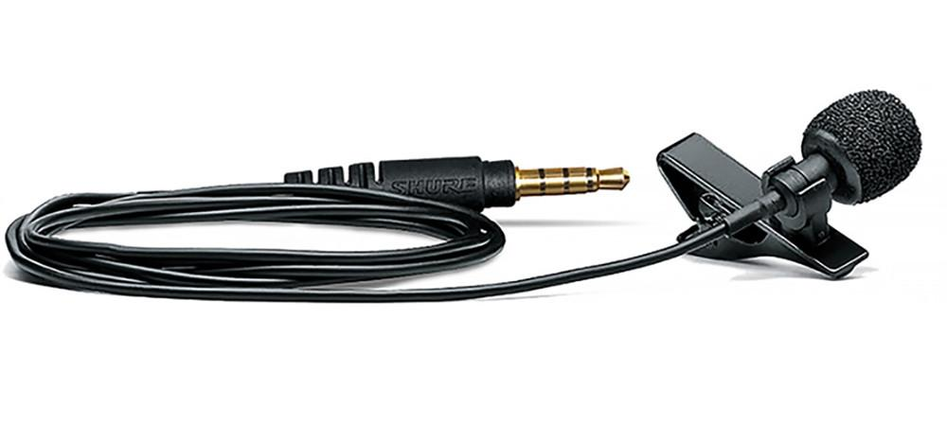
Other Commonly Used Mics
Shotgun Mic - Used commonly for interviews. Directional mic that picks up audio between 1 and 3 feet.
Lav Mic - Used commonly for interviews. Attached onto subjects’ shirt or area near their mouth to pick up their voice.

Slide 5
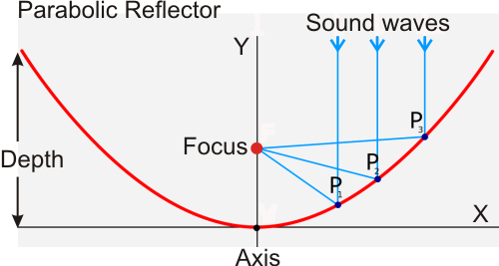
How it works?
Anything approaching the dish that is parallel to the dish’s center line and perpendicular to the directrix* is then reflected and focused to a single point.
When a parallel line hits the inner surface at any point, the slope at that point will reflect the line into the "focus" of the parabola.
An infinite number of parallel lines could hit and they all would go to the focus
Sound Energy to Electrical Energy
Extreme precision needed
The slightest turn can disrupt the audio

Slide 6
Most Important Factor!!
The SHAPE is the most important factor in the creation of a parabolic microphone.
The microphone needs to match specifications exactly or else the collection of the sound suffers.
Sounds comes out distorted
Amplification is reduced due to sound energy being scattered focused on a single point.

Slide 7
The Math Behind It All
A parabola is a set of all points in a plane that are equidistant from a fixed line (directrix) and fixed point (focus) in the plane.
Axis of the parabola - the line that goes through the focus and is perpendicular to the directrix
Vertex of the parabola - the point of intersection of the parabola with the axis.
Anything approaching the dish that is parallel to the dish’s center line and perpendicular to the directrix is then reflected and focused to a single point (the focus!)

Slide 8
Math cont.

Slide 9
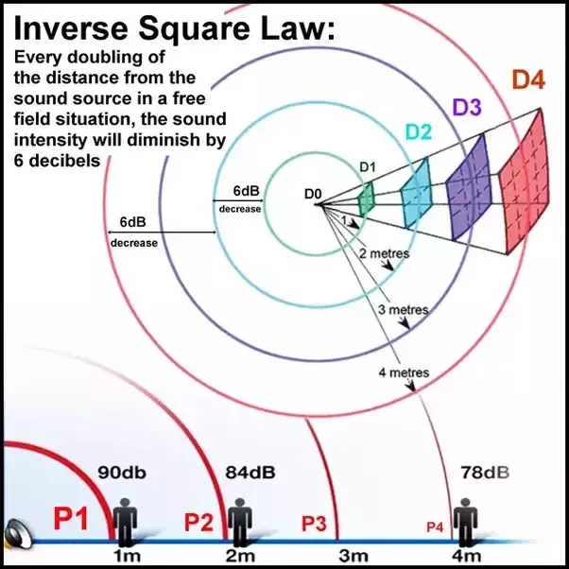
Does Distance Affect the Volume?
The audio signal is reduced by 6dB when the distance is doubled.
The amplifier is able to gather all the sound it picks up and increase the audio and noise levels.
Inverse Square Law - a law stating that a
specified physical quantity or intensity changes
in inverse proportion to the square of
the distance from the source.

Slide 10
Application Example
Question:
The cross section of a satellite dish is a parabola. Signals from a satellite strike the surface of the dish and are reflected to a single point (the focus), where the receiver is located. If the dish is 16 feet across at its opening and 2 feet deep at its center , at what a position should the receiver be placed? (Find p)

Slide 11
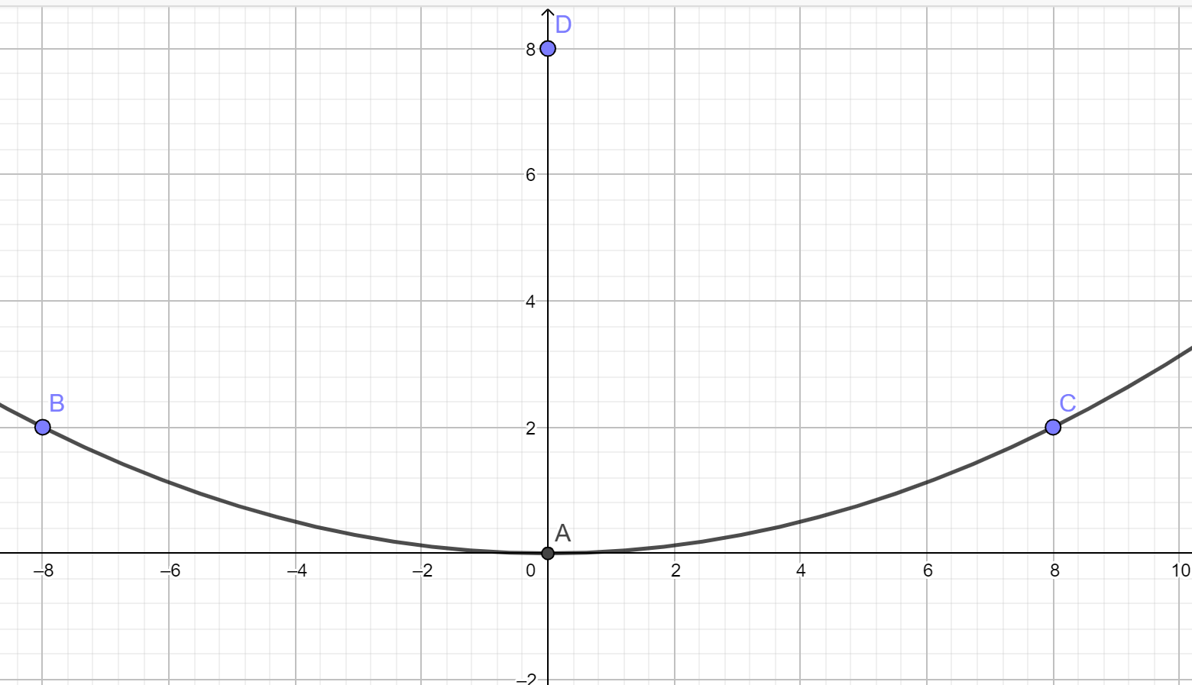
Application Example cont.

Slide 12
Example Breakdown
16 Feet apart (8 each side) = x
2 feet deep = y
Focus equation: x² = 4py where p is the focus
(8)² = 4p(2)
64 =8p
p=8
This means that the receiver needs to be 8 feet above the vertex!

Slide 13
Resources
https://kloverproducts.com/klover-mik/how-parabolic-microphones-work/
http://www.onlinegrecoaching.com/coordinate-geometry-parabola/
https://colalg.math.csusb.edu/~devel/precalcdemo/conics/src/parabola.html
https://www.wildtronics.com/parabolicarticle.html#.XMivc-hKg2z

